Slide 1
Chapter 39 Web Services

Slide 2
Objectives
To describe what a Web service is (§39.1).
To create a Web service class (§39.2).
To publish and test a Web service (§39.3).
To create a Web service client reference (§39.4).
To explain the role of WSDL (§39.4).
To pass object type of arguments in a Web service (§39.5).
To discover how a client communicates with a Web service (§39.5).
To describe what are SOAP request and SOAP response (§39.5).
To track a session in Web services (§39.6).

Slide 3
What is a Web Service?
Web service is a technology that enables programs to communicate through HTTP on the Internet. Web services enable a program on one system to invoke a method in an object on another system. You can develop and use Web services using any languages on any platform. Web services are simple and easy to develop.

Slide 4
What is SOAP?
Web services run on the Web using HTTP. There are several APIs for Web services. A popular standard is the Simple Object Access Protocol (SOAP), which is based on XML. The computer on which a Web service resides is referred to as a server. The server needs to make the service available to the client, known as publishing a Web service. Using a Web service from a client is known as consuming a Web service.

Slide 5
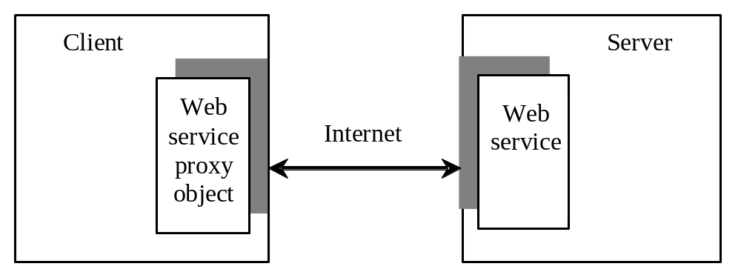
How does a client communicate with a Web service
A client interacts with a Web service through a proxy object. The proxy object facilitates the communication between the client and the Web service. The client passes arguments to invoke methods on the proxy object. The proxy object sends the request to the server and receives the result back from the server, as shown in Figure 39.1.

Slide 6
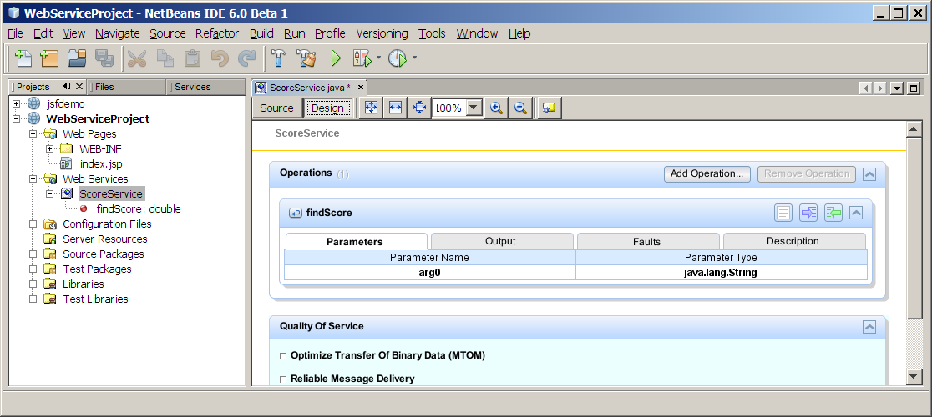
Creating Web Services Using NetBeans
Create a Web project, Create a Web service, deploy Web service

Slide 7
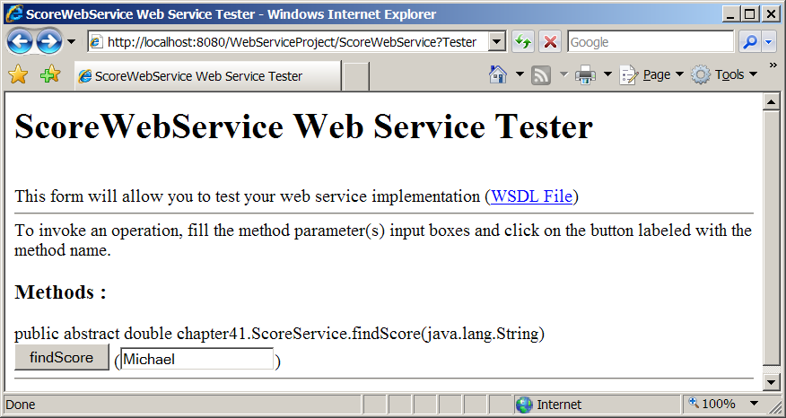
Testing Web Services

Slide 8
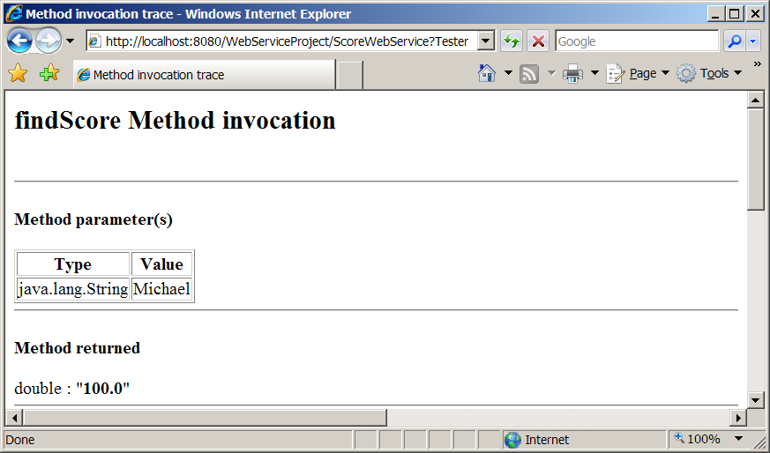
Testing Web Services

Slide 9
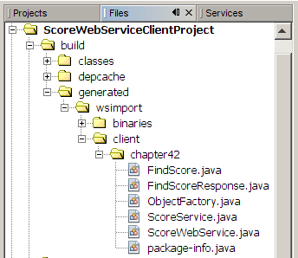
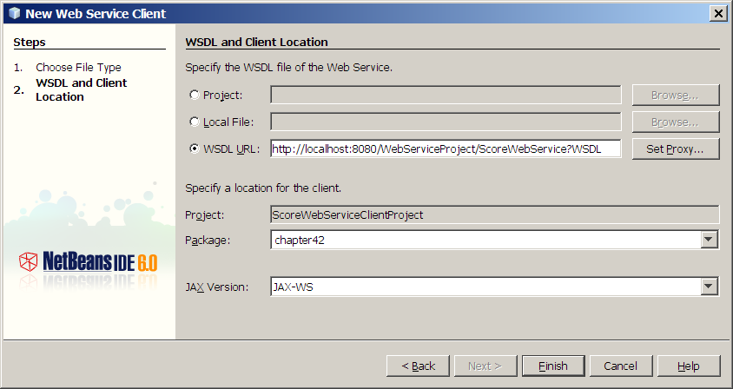
Consuming Web Services
Creating a Web service client

Slide 10
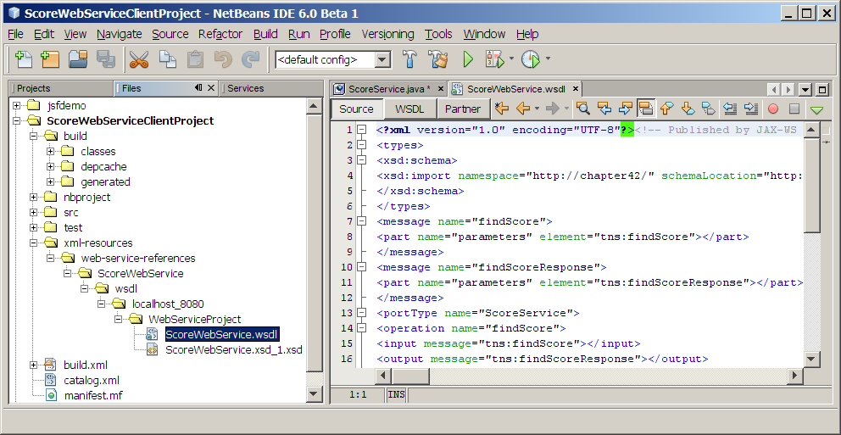
What is WSDL?
When you created a Web service reference, you entered a WSDL URL, as shown in Figure 39.6. A .wsdl file is created under the xm-resources folder, as shown in Figure 39.8. So what is WSDL? WSDL stands for Web Service Description Language. A .wsdl file is an XML file that describes the available Web service to the client, i.e., the remote methods, their parameters, and return value types, etc.

Slide 11
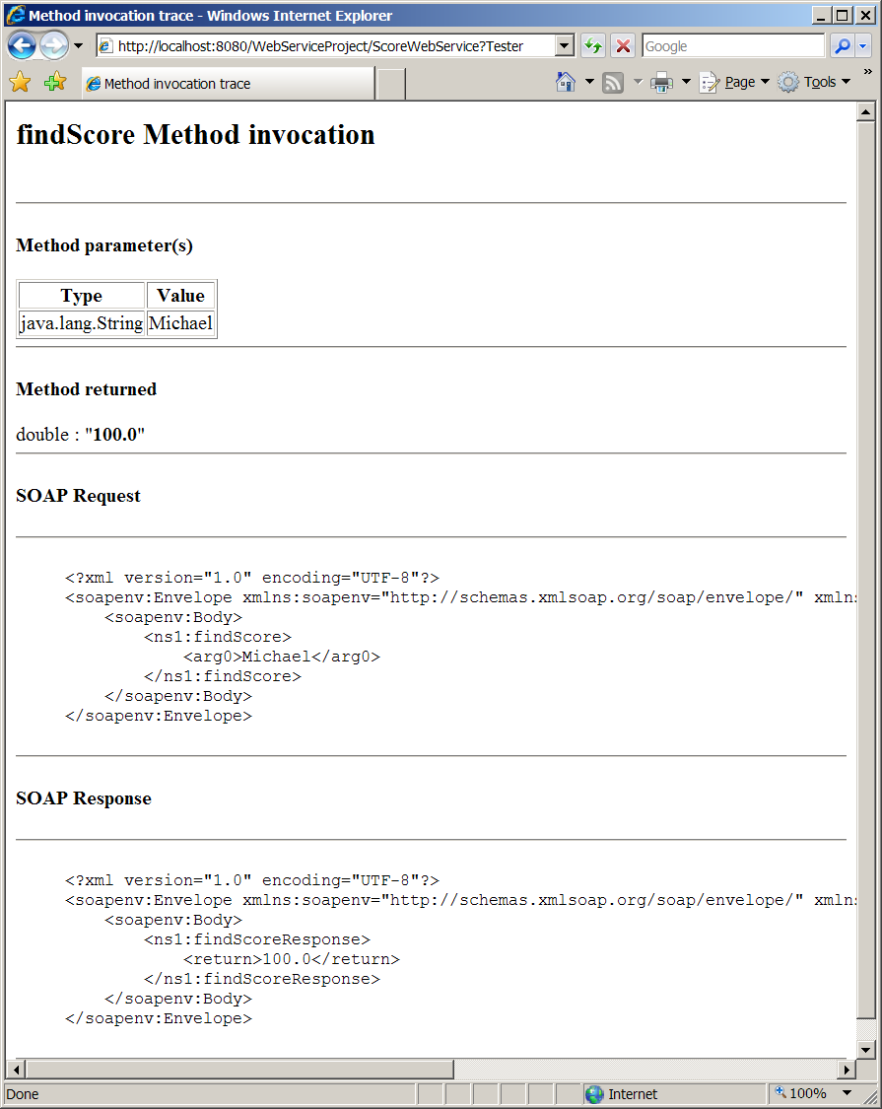
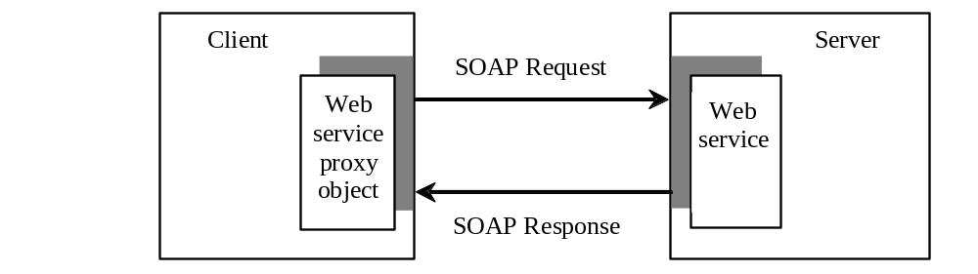
Passing and Returning Arguments

Slide 12
XML serialization/deserialization
Can you pass an argument of any type between a client and a Web service? No. SOAP only supports primitive types, wrapper types, arrays, String, Date, Time, List, and several other types. It also supports certain custom classes. An object that is sent to or from a server is serialized into XML. The process of serializing/deserialization objects, called XML serialization/deserialization, is performed automatically. For a custom class to be used with Web methods, the class must meet the following requirements:
  The class must have a no-arg constructor.
  Instance variables that should be serialized must have public get and set methods. The classes of these variables must be supported by SOAP.

Slide 13
Web Service Session Tracking
§37.8.3, “Session Tracking Using the Servlet API,” introduced session tracking for servlets using the javax.servlet.http.HttpSession interface. You can use HttpSession to implement session tracking for Web services. To demonstrate this, consider an example that generates random True/False questions for the client and grades the answers on these questions for the client.

